Slide 1
Substrate
Silicon substrate with micropillar:
Diameter 20um; periodicity 40 um; height 40um.
Fluorinated silane (Trichloro(1H,1H,2H,2H-perfluorooctyl)-silane, Sigma Aldrich) is conformally coated on the silicon substrate through chemical vapor deposition process for about 1 hour. Then put the substrate on hot plate with 90 °C for about 1 hour.

Slide 2
Contact Angle and Contact radius
100 °C hot plate
110 °C hot plate

Slide 3
Droplet volume and spherical cap assumption
100 °C hot plate
110 °C hot plate

Slide 4
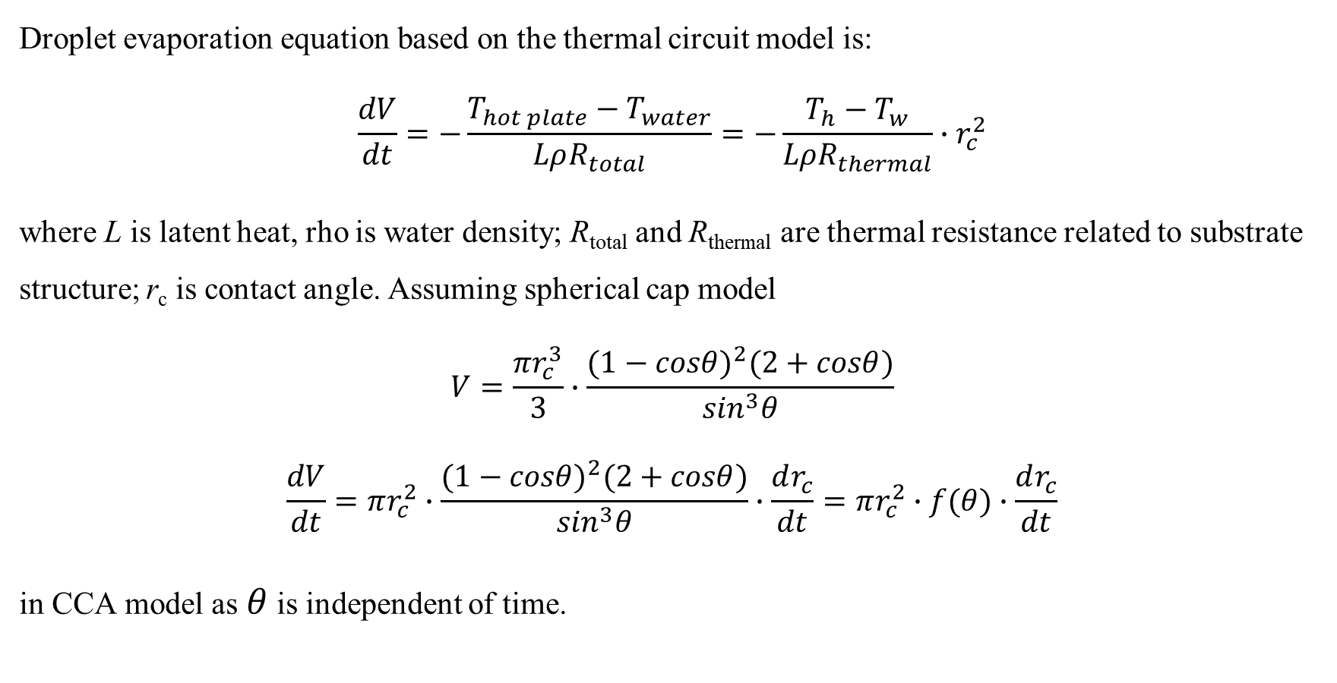
Evaporation equation
Droplet evaporation equation based on the thermal circuit model is:
$$\frac{dV}{dt}=−\frac{T_{hot plate}−T_{water}}{LρR_{total}}=−\frac{T_{h}−T_{w}}{LρR_{thermal}}∙r_{c}^{2}$$
where L is latent heat, rho is water density; R_{total} and R_{thermal} are thermal resistance related to substrate structure; r_{c} is contact angle. Assuming spherical cap model
$$V=\frac{πr_{c}^{3}}{3}∙\frac{{(1−cosθ)}^{2}(2+cosθ)}{\sin^{3}θ}$$
$$\frac{dV}{dt}=πr_{c}^{2}∙\frac{{(1−cosθ)}^{2}(2+cosθ)}{\sin^{3}θ}∙\frac{dr_{c}^{ }}{dt}=πr_{c}^{2}∙f(θ)∙\frac{dr_{c}^{ }}{dt}$$
in CCA model as$θ$ is independent of time.

Slide 5
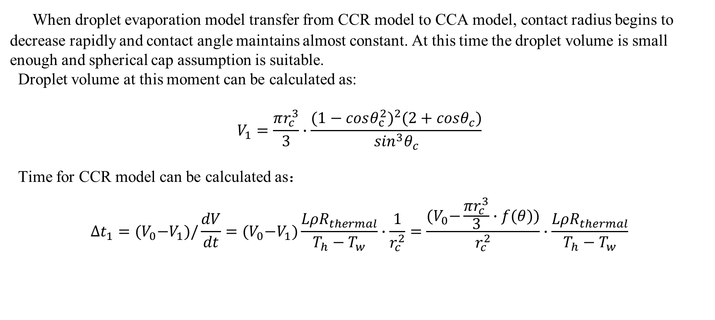
Droplet evaporation in CCR model
When droplet evaporation model transfer from CCR model to CCA model, contact radius begins to decrease rapidly and contact angle maintains almost constant. At this time the droplet volume is small enough and spherical cap assumption is suitable.
Droplet volume at this moment can be calculated as:
$$V_{1}=\frac{πr_{c}^{3}}{3}∙\frac{{(1−cosθ_{c}^{2})}^{2}(2+cosθ_{c})}{\sin^{3}θ_{c}}$$
Time for CCR model can be calculated as：
$$∆t_{1}={(V}_{0}−V_{1})/\frac{dV}{dt}={(V}_{0}−V_{1})\frac{LρR_{thermal}}{T_{h}−T_{w}}∙\frac{1}{r_{c}^{2}}=\frac{{(V}_{0}−\frac{πr_{c}^{3}}{3}∙f(θ))}{r_{c}^{2}}∙\frac{LρR_{thermal}}{T_{h}−T_{w}}$$

Slide 6
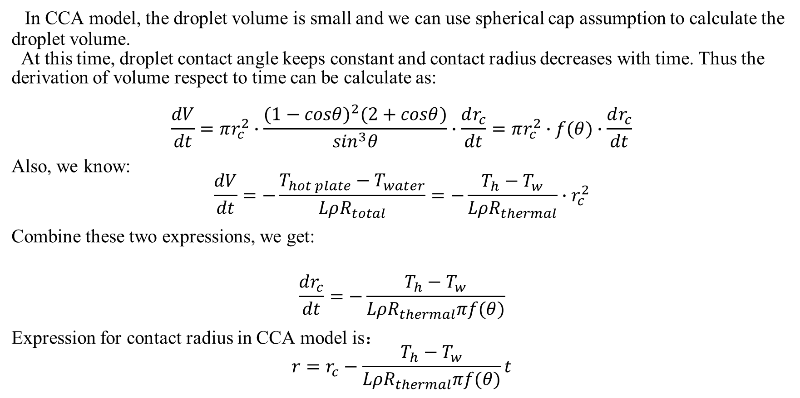
Droplet evaporation in CCA model
In CCA model, the droplet volume is small and we can use spherical cap assumption to calculate the droplet volume.
At this time, droplet contact angle keeps constant and contact radius decreases with time. Thus the derivation of volume respect to time can be calculate as:
$$\frac{dV}{dt}=πr_{c}^{2}∙\frac{{(1−cosθ)}^{2}(2+cosθ)}{\sin^{3}θ}∙\frac{dr_{c}^{ }}{dt}=πr_{c}^{2}∙f(θ)∙\frac{dr_{c}^{ }}{dt}$$
Also, we know:
$$\frac{dV}{dt}=−\frac{T_{hot plate}−T_{water}}{LρR_{total}}=−\frac{T_{h}−T_{w}}{LρR_{thermal}}∙r_{c}^{2}$$
Combine these two expressions, we get:
$$\frac{dr_{c}^{ }}{dt}=−\frac{T_{h}−T_{w}}{LρR_{thermal}πf(θ)}$$
Expression for contact radius in CCA model is：
$$r=r_{c}^{ }−\frac{T_{h}−T_{w}}{LρR_{thermal}πf(θ)}t$$

Slide 7
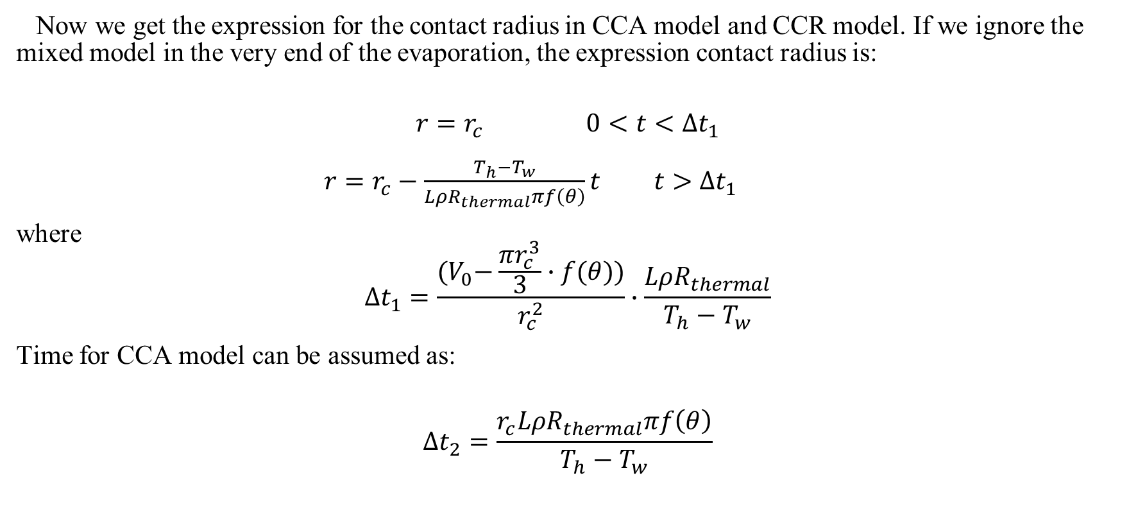
Expression for contact radius in the whole evaporation process
Now we get the expression for the contact radius in CCA model and CCR model. If we ignore the mixed model in the very end of the evaporation, the expression contact radius is:
$$r=r_{c } 0<t<∆t_{1}$$
$r=r_{c}^{ }−\frac{T_{h}−T_{w}}{LρR_{thermal}πf\left(θ\right)}t t>∆t_{1}$
where
$$∆t_{1}=\frac{{(V}_{0}−\frac{πr_{c}^{3}}{3}∙f(θ))}{r_{c}^{2}}∙\frac{LρR_{thermal}}{T_{h}−T_{w}}$$
Time for CCA model can be assumed as:
$$∆t_{2}=\frac{r_{c}^{ }LρR_{thermal}πf\left(θ\right)}{T_{h}−T_{w}}$$

Slide 8
Predicted contact radius
100 °C hot plate
110 °C hot plate

Slide 9
Volume calculated by predicted contact radius
100 °C hot plate
110 °C hot plate

Slide 10
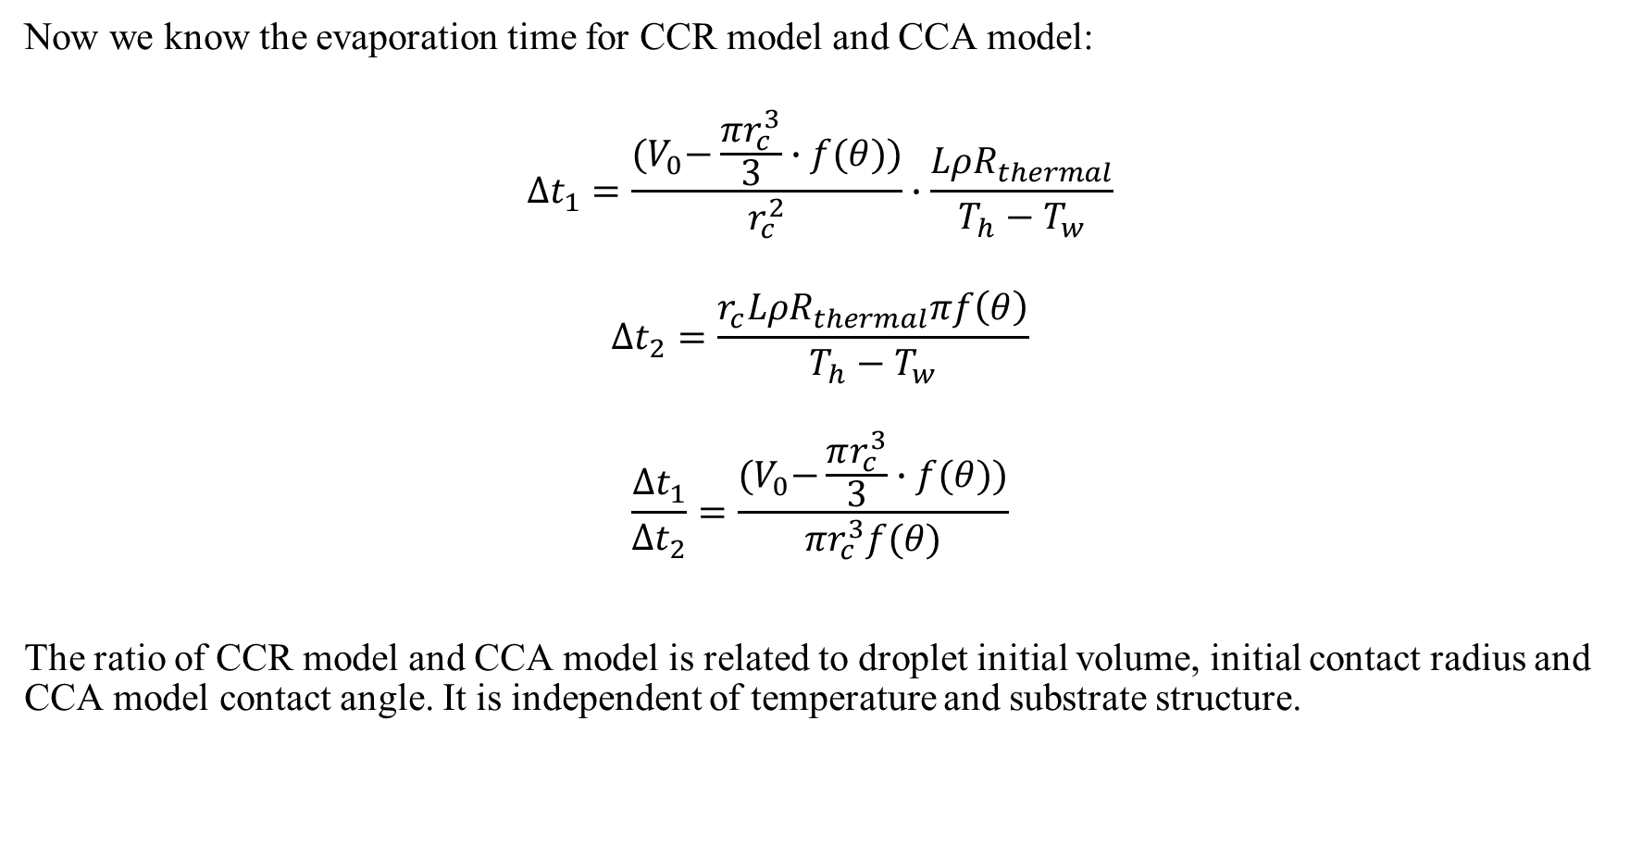
Ratio of CCR model and CCA model
Now we know the evaporation time for CCR model and CCA model:
$$∆t_{1}=\frac{{(V}_{0}−\frac{πr_{c}^{3}}{3}∙f(θ))}{r_{c}^{2}}∙\frac{LρR_{thermal}}{T_{h}−T_{w}}$$
$$∆t_{2}=\frac{r_{c}^{ }LρR_{thermal}πf\left(θ\right)}{T_{h}−T_{w}}$$
$$\frac{∆t_{1}}{∆t_{2}}=\frac{{(V}_{0}−\frac{πr_{c}^{3}}{3}∙f(θ))}{{πr}_{c}^{3}f(θ)}$$
The ratio of CCR model and CCA model is related to droplet initial volume, initial contact radius and CCA model contact angle. It is independent of temperature and substrate structure.

Slide 11
Normalized evaporation data

Slide 12
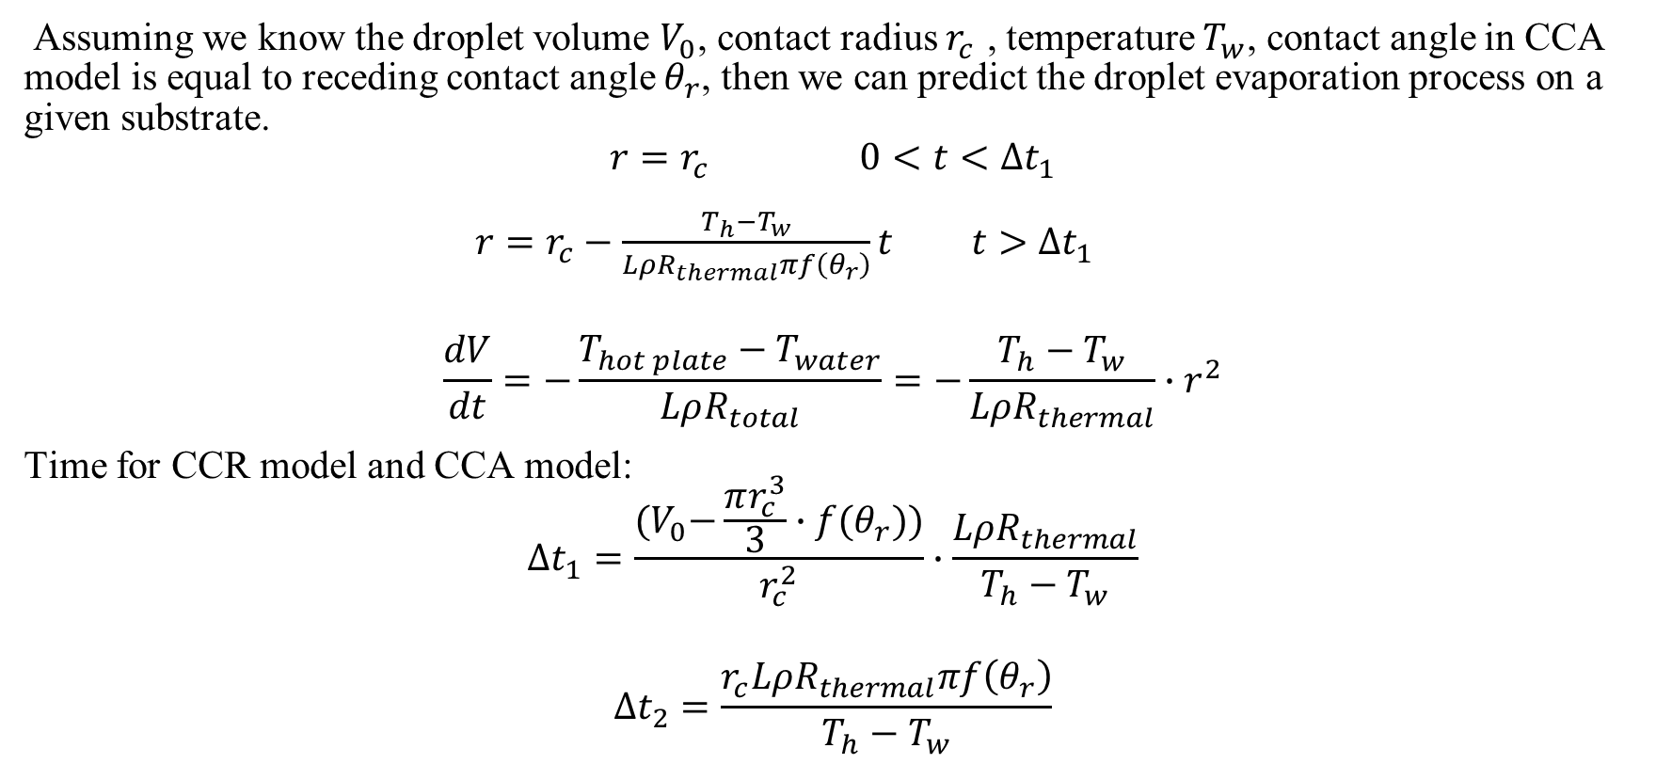
Prediction model
Assuming we know the droplet volume $V_{0}$, contact radius $r_{c }$, temperature $T_{w}$, contact angle in CCA model is equal to receding contact angle $θ_{r}$, then we can predict the droplet evaporation process on a given substrate.
$$r=r_{c } 0<t<∆t_{1}$$
$r=r_{c}^{ }−\frac{T_{h}−T_{w}}{LρR_{thermal}πf\left(θ_{r}\right)}t t>∆t_{1}$
$$\frac{dV}{dt}=−\frac{T_{hot plate}−T_{water}}{LρR_{total}}=−\frac{T_{h}−T_{w}}{LρR_{thermal}}∙r_{ }^{2}$$
Time for CCR model and CCA model:
$$∆t_{1}=\frac{{(V}_{0}−\frac{πr_{c}^{3}}{3}∙f(θ_{r}))}{r_{c}^{2}}∙\frac{LρR_{thermal}}{T_{h}−T_{w}}$$
$$∆t_{2}=\frac{r_{c}^{ }LρR_{thermal}πf\left(θ_{r}\right)}{T_{h}−T_{w}}$$

Slide 13
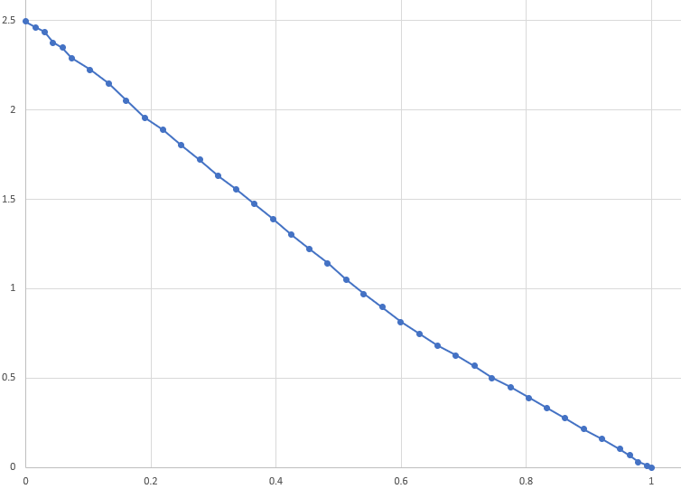

Slide 14
